Slide 1
Schriftartenerkennung mit CNN
Alexander Taubert

Slide 2
Schriftartenerkennung mit CNN
Bilderformat 1200 x 40 x 3 (w x h x c)
Labels 1-12 (Schriftarten)
Arial
Calibri
Canterbury
Comic_san_ms
Courier_new
Forte
Jokerman
Monofont
Times_new_roman
Times_new_romance
Unispace_rg
Waltograph_ui

Slide 3
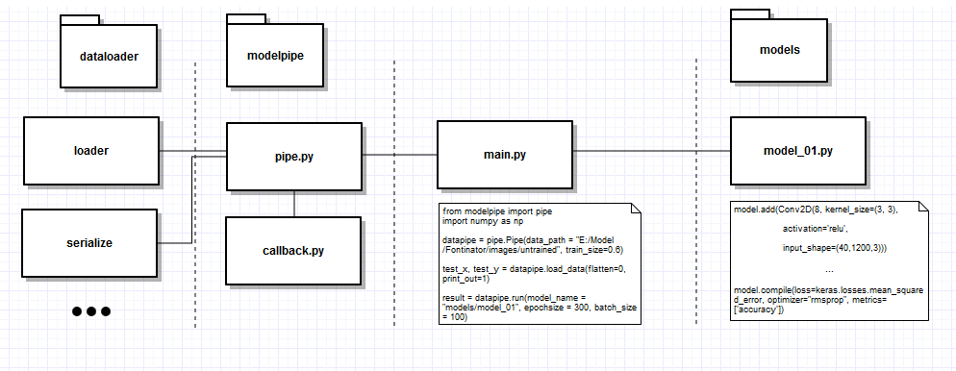
Schriftartenerkennung mit CNN

Slide 4
Schriftartenerkennung mit CNN

Slide 5
Model 1 – Basic Model
model.add(Conv2D(8, kernel_size=(3, 3), activation='relu‘, input_shape=(40,1200,3)))
model.add(MaxPooling2D(pool_size=(2, 2)))
model.add(Conv2D(16, kernel_size=(3, 3), activation='relu'))
model.add(MaxPooling2D(pool_size=(2, 2)))
model.add(Conv2D(24, kernel_size=(3, 3), activation='sigmoid'))
model.add(MaxPooling2D(pool_size=(2, 2)))
model.add(Dropout(0.2))
model.add(Flatten())
model.add(Dense(256, activation='relu'))
model.add(Dropout(0.4))
model.add(Dense(len(classes), activation='softmax'))
model.compile(loss=keras.losses.mean_squared_error, optimizer="rmsprop", metrics=['accuracy'])

Slide 6
Model 2 – 5x5 Kernel
model.add(Conv2D(8, kernel_size=(5, 5), activation='relu‘, input_shape=(40,1200,3)))
model.add(MaxPooling2D(pool_size=(2, 2)))
model.add(Conv2D(16, kernel_size=(3, 3), activation='relu'))
model.add(MaxPooling2D(pool_size=(2, 2)))
model.add(Conv2D(24, kernel_size=(3, 3), activation='sigmoid'))
model.add(MaxPooling2D(pool_size=(2, 2)))
model.add(Dropout(0.2))
model.add(Flatten())
model.add(Dense(256, activation='relu'))
model.add(Dropout(0.4))
model.add(Dense(len(classes), activation='softmax'))
model.compile(loss=keras.losses.mean_squared_error, optimizer="rmsprop", metrics=['accuracy'])

Slide 7
Model 3 – 9x9 Kernel
model.add(Conv2D(8, kernel_size=(9, 9), activation='relu‘, input_shape=(40,1200,3)))
model.add(MaxPooling2D(pool_size=(2, 2)))
model.add(Conv2D(16, kernel_size=(3, 3), activation='relu'))
model.add(MaxPooling2D(pool_size=(2, 2)))
model.add(Conv2D(24, kernel_size=(3, 3), activation='sigmoid'))
model.add(MaxPooling2D(pool_size=(2, 2)))
model.add(Dropout(0.2))
model.add(Flatten())
model.add(Dense(256, activation='relu'))
model.add(Dropout(0.4))
model.add(Dense(len(classes), activation='softmax'))
model.compile(loss=keras.losses.mean_squared_error, optimizer="rmsprop", metrics=['accuracy'])

Slide 8
Model 4 – Extra Conv2D Layer
model.add(Conv2D(8, kernel_size=(3, 3), activation='relu‘, input_shape=(40,1200,3)))
model.add(MaxPooling2D(pool_size=(2, 2)))
model.add(Conv2D(16, kernel_size=(3, 3), activation='relu'))
model.add(MaxPooling2D(pool_size=(2, 2)))
model.add(Conv2D(24, kernel_size=(3, 3), activation='sigmoid‘))
model.add(Conv2D(24, kernel_size=(3, 3), activation='sigmoid'))
model.add(MaxPooling2D(pool_size=(2, 2)))
model.add(Dropout(0.2))
model.add(Flatten())
model.add(Dense(256, activation='relu'))
model.add(Dropout(0.4))
model.add(Dense(len(classes), activation='softmax'))
model.compile(loss=keras.losses.mean_squared_error, optimizer="rmsprop", metrics=['accuracy'])

Slide 9
Model 5 – Extra Dense Layer
model.add(Conv2D(8, kernel_size=(3, 3), activation='relu‘, input_shape=(40,1200,3)))
model.add(MaxPooling2D(pool_size=(2, 2)))
model.add(Conv2D(16, kernel_size=(3, 3), activation='relu'))
model.add(MaxPooling2D(pool_size=(2, 2)))
model.add(Conv2D(24, kernel_size=(3, 3), activation='sigmoid'))
model.add(MaxPooling2D(pool_size=(2, 2)))
model.add(Dropout(0.2))
model.add(Flatten())
model.add(Dense(256, activation='relu‘))
model.add(Dense(256, activation='relu'))
model.add(Dropout(0.4))
model.add(Dense(len(classes), activation='softmax'))
model.compile(loss=keras.losses.mean_squared_error, optimizer="rmsprop", metrics=['accuracy'])

Slide 10
Model 6 – Less Filters
model.add(Conv2D(4, kernel_size=(3, 3), activation='relu‘, input_shape=(40,1200,3)))
model.add(MaxPooling2D(pool_size=(2, 2)))
model.add(Conv2D(8, kernel_size=(3, 3), activation='relu'))
model.add(MaxPooling2D(pool_size=(2, 2)))
model.add(Conv2D(16, kernel_size=(3, 3), activation='sigmoid'))
model.add(MaxPooling2D(pool_size=(2, 2)))
model.add(Dropout(0.2))
model.add(Flatten())
model.add(Dense(256, activation='relu'))
model.add(Dropout(0.4))
model.add(Dense(len(classes), activation='softmax'))
model.compile(loss=keras.losses.mean_squared_error, optimizer="rmsprop", metrics=['accuracy'])

Slide 11
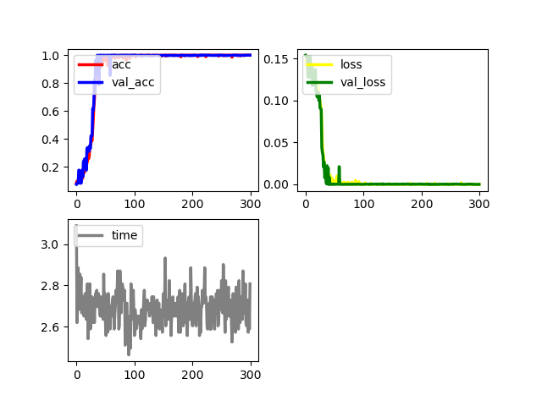
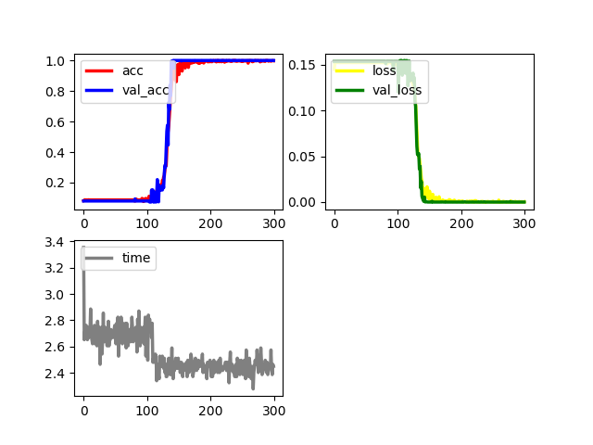
Schriftartenerkennung mit CNN
Model 1 – Basic Model
Model 2 – 5x5 Kernel

Slide 12
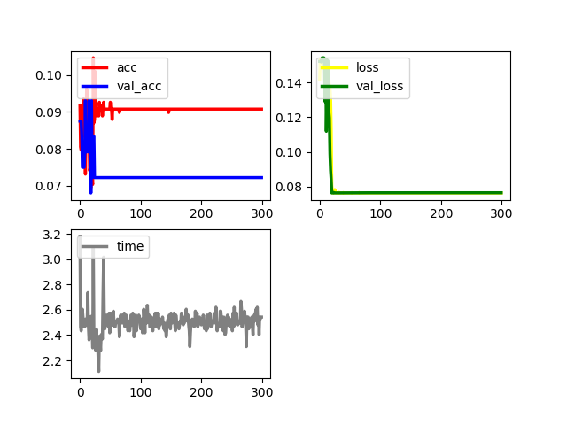
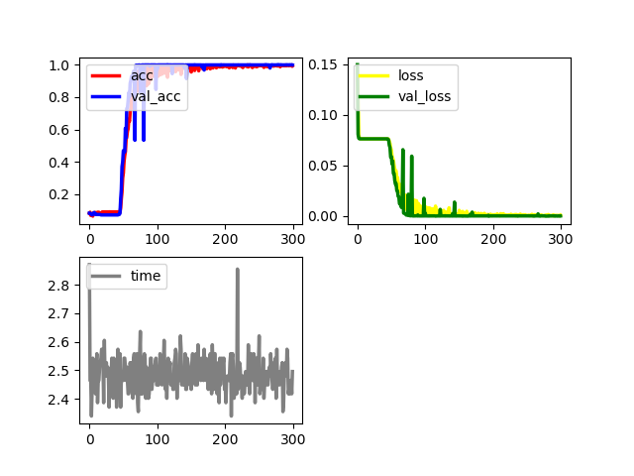
Schriftartenerkennung mit CNN
Model 3 – 9x9 Kernel
Model 4 – Extra Conv2D Layer

Slide 13
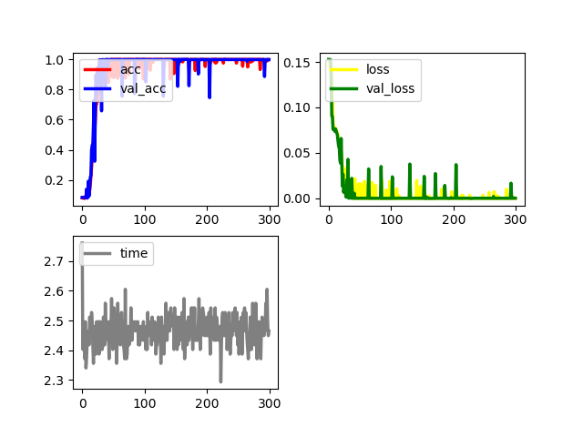
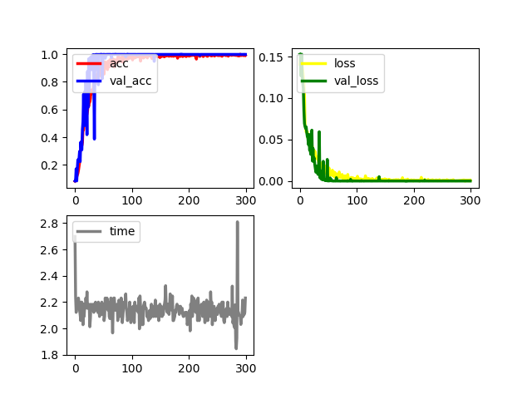
Schriftartenerkennung mit CNN
Model 5 – Extra Dense Layer
Model 6 – Less Filters

Slide 14
Schriftartenerkennung mit CNN
Nicht jedes Netz ist für jede Aufgabe geeignet
Kleine Änderungen haben große Auswirkungen
Manchmal ist der Zufall entscheidend
Die Genauigkeit steigt schnell oder gar nicht

